Slide 1


الْمُعَوِّذَتَيْن
Al-Mu'awwidhatayn
Naas
114
Falaq
113

Slide 2

بِسۡمِ اللهِ الرَّحۡمٰنِ الرَّحِيۡمِ
(اے رسول(ص) آپ کہہ دیجئے کہ میں پناہ لیتا ہوں صبح کے پروردگار کی۔
قُلۡ اَعُوۡذُ بِرَبِّ الۡفَلَقِۙ‏
Say: I take refuge with the Lord of the dawn
ہر اس چیز کے شر سے جو اس نے پیدا کی ہے۔
مِنۡ شَرِّ مَا خَلَقَۙ‏
From the evil of what He has created
اور رات کی تاریکی کے شر سے جبکہ وہ چھا جائے۔
وَمِنۡ شَرِّ غَاسِقٍ اِذَا وَقَبَۙ
And from the evil of the dark night when it comes
اوران کے شر سے جو گِرہوں میں پھونکے مارتی ہیں۔
وَمِنۡ شَرِّ النَّفّٰثٰتِ فِى الۡعُقَدِۙ‏
And from the evil of those who blow on knots
اورحاسد کے شر سے جب وہ حسد کرے۔
وَمِنۡ شَرِّ حَاسِدٍ اِذَا حَسَدَ‏
And from the evil of the envious (one) when he envies

Slide 3

بِسۡمِ اللهِ الرَّحۡمٰنِ الرَّحِيۡمِ
(اے رسول(ص) آپ کہہ دیجئے کہ میں پناہ لیتا ہوں سب لوگوں کے پروردگار کی۔
قُل أَعوذُ بِرَبِّ النّاسِ
Say: I take refuge with the Lord of Mankind
سب انسانوں کے بادشاہ کی
مَلِكِ النّاسِ
The King of Mankind
سب لوگوں کے الٰہ (خدا) کی
إِلٰهِ النّاسِ
The God of Mankind
بار بار وسوسہ ڈالنے بار بار پسپا ہونے والے کے شر سے
مِن شَرِّ الوَسواسِ الخَنّاسِ
From the evil of the slinking whisperer
جو لوگوں کے دلوں میں وسوسہ ڈالتا ہے
الَّذي يُوَسوِسُ في صُدورِ النّاسِ
Who whispers evil into the hearts of Mankind
خواہ وہ جِنوں میں سے ہوں یا انسانوں میں سے
مِنَ الجِنَّةِ وَالنّاسِ
From among Jinn and Mankind

Slide 4

Merits of Recitation
It is narrated from the Prophet (S) that whoever recites the two surahs of al-Naas and al-Falaq is like someone who has recited all the books of divine prophets (A).
It is narrated from Imam al-Baqir (A) that whoever recites the surahs of
al-Mu'awwidhatayn in three rak'as of his night prayer (Shaf' and Watr prayers), he will be told that, "O servant of God! The good news is for you that God accepted your Watr prayer.
It is reported that the Prophet (S) mentioned the two surahs of al-Falaq and al-Naas are the most beloved surahs before God.

Slide 5


A Mother’s Day Advice
Teach your children, the Al-Mu'awwidhatayn and then help them memorize it.
Get them in the habit of reciting it daily before bedtime.
HAPPY MOTHER’S DAY

Slide 6
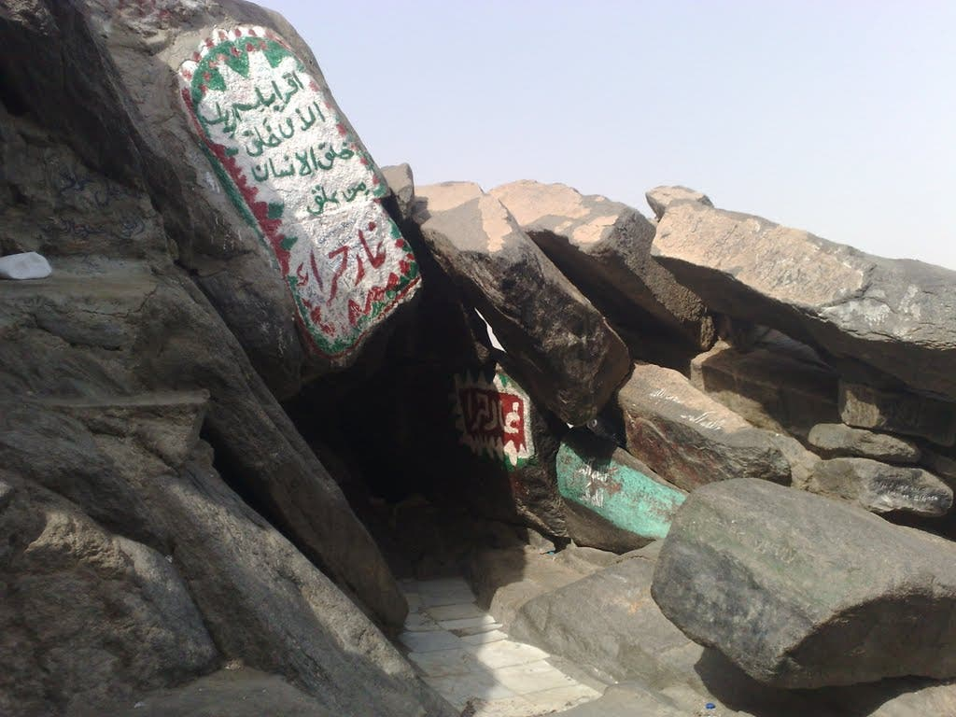
Occasion of Revelation
In his commentary, Ali b. Ibrahim al-Qummi transmitted a hadith from Imam al-Sadiq (A); and, in al-Burhan, al-Sayyid Hashim al-Bahrani transmitted a hadith by Fudayl b. Yasar from Imam al-Baqir (A) that, the Prophet (S) became sick and his fever rose. Then, angel Jabra'il (Gabriel) brought these two surahs to heal the Prophet (S) (angel Gabriel began reciting Surah al-Falaq upon his head and angel Mika'il (Michael) recited Surah al-Naas at his feet to cure him.)

Slide 7
B
R
E
A
K
D
O
W
N
Allah’s (Rabb) refuge is sought
Allah’s (Rabb) refuge is sought
1
1
Allah’s (King) refuge is sought
Mention of EVIL
2
GENERAL
Allah’s (God) refuge is sought
3
What HE has created
2
MAIN EVIL
SPECIFIC
Shaytan is the main EVIL
4
EVIL of Dark Night
3
DESCRIPTION OF SHAYTAN
EVIL of Blower on the Knots
What Shaytan DOES
4
5
EVIL of Envy & Jealousy
WHO can be from Shayateen
5
6
3
# of times, refuge is sought
1
# of times, refuge is sought
1
# of evils mentioned
3
# of evils mentioned

Slide 8
RABB Absolute Owner
KEY WORDS
SHARR Think of sharara, spark (evil) that can harm you
MAALIK King or Ruler (Owner)
GHAASIQIN Comes from Ghasaq – the first part of night
ILAHA Lord, one you worship (Owner)
WAQAB Darkness
NAAS Human - Comes from Nasiyya – to be forgetful
NAF-FATHAAT Women who blow on knots
KHANNAAS The one who withdraws
An Example of the Whispering Shaytan Shaytan incites people to get angry, because anger is a manifestation
of the ego/arrogance. If a believer gets angry and does not seek refuge in Allah out of arrogance - so shaytan has succeeded twice.
Note, that only AL-NAF-FATHAAT has an AL in front of it. This is to emphasize that every one of them is an evil. Until this ayah was revealed, the blowing on the knots in the darkness of the night in secrecy was not known to public.

Slide 9
GENERAL INFO
Mu'awwidha
ALSO KNOWN AS
Mu'awwidha
Makkah
REVEALED IN
Makkah
Mufassalat
CLASSIFICATION
Mufassalat
al-Mu'awwidhatayn
SET IS KNOWN AS
al-Mu'awwidhatayn
Mushaqshaqatayn
SET ALSO REFERRED TO AS
Mushaqshaqatayn
21st
ORDER OF REVELATION
20th
114
CURRENT COMPILATION
113
06 / 20 /78
AYAAH / WORDS / LETTERS
05 /23 /73

Slide 10
Deals with Afflictions that affect our Actions
AFFLICTIONS
Deals with External Affliction
We have no control over External Afflictions (the Other Creations)
Depending on the state of our heart, we can overcome these Afflictions
Less Powerful than Internal Afflictions (So refuge has been sought once)
Waswasa from Shaytan can affect our Emaan (So refuge has been sought thrice)
Seeking refuge
at all stages
(Explained in the next slide)
Seeking refuge from the Master of Falaq who can help us pierce the dark sky of Dhulumaat (Shirk) and bless us with the Noor (Tawheed)

Slide 11
Repetition of Naas (3 times)
NOTE the beautiful psychological progression
What if people are facing problem?
We go to STEP ONE (RABB)
Child goes to caretaker
Slave goes to master
Employee goes to his boss
And if the problem is not solved. The next step is:
We go to STEP TWO
(MALIK/KING)
King/Ruler/Government
Problem still not solved. So, what is next?
We go to STEP THREE
(ILAHA/LORD)
None of the creation can help you, so now you pray to God

Slide 12
Why does Allah want us to ASK?
Allah wants humans to announce their weakness with their tongues. Allah wants the human to say they are weak, helpless, and powerless, and that they needs help from Allah who is greater than him.
This cry instills:
HUMILITY in us
Removes EGO and SELF PRIDE
Gets rid of the FALSE SENSE “I don’t need protection”.
REMEMBER
The human rebels, he sees himself
as self sufficient ('Alaq 96: 6-7)

Slide 13
THE MAIN EVIL
In Surah an-Naas, we get even more specific information as to the root cause of this envying
problem - the shaytan himself who puts waswasa into the hearts of the people.
In Surah al-Falaq, we recognize the outwardly problem of Jealousy.
وَمِنۡ شَرِّ حَاسِدٍ اِذَا حَسَدَ‏
Who is the most jealous against the believers?
مِن شَرِّ الوَسواسِ الخَنّاسِ
Iblees,
the shaytan/devil

Slide 14
Humans
Daybreak
رَبِّ النّاسِ
رَبِّ الۡفَلَقِ‏
Humans carry a HEART. Four words have been used in the Holy Qur’an to describe the stages / states of human heart.
THE RABB
While the literal meaning of Falaq is Daybreak, here it is used in the context of ripping and tearing through all the problems you have. Those problems are:
SADR
NIGHT is a time of fear
QALB
JEALOUSY is a feeling where someone can potentially harm you
FU’AAD
MAGIC puts you under difficulty internally, as well as other external factors.
LUBB

Slide 15
HEART, According to the Holy Qur’an
Sadr
Means CHEST, and when Allah alludes to motives or secrets.
Qalb
Something that turns around and about and upside down. When Allāh refers to emaan and diseases of the heart, Qalb is used.
Fu’aad
Means burning or a flame. Fu’aad is used in the Qur’an to describe the heart when it is engrossed in emotion: happiness, sadness, lust, frustration, anger or regret
Lubb
Mind/Heart not disturbed by vain and miniscule things. Not afraid to spend time with yourself.

Slide 16
Shaytan can only reach SADR …
Devils primary goal is to whisper in your Sadr, so that evil is instilled in your Qalb – but he does not have a direct access to Qalb. If our Emaan is strong, the waswasa should not have an impact. If we are forgetful or careless, shaytan’s whisper will find itsway to your Qalb.
A Qalb filled with Emaan will save us from the
two possible diseases:
Shubahat
Shahawat
The Fu’aad will be toward content, rather than lust leading us to the journey of Ulil-Albaab.

Slide 17
Physiologists about Lubb
Two physiologists in the 1970s, John and Beatrice Lacey, conducted a study and found that the brain sent messages to the heart, but that the heart did not automatically obey the messages. Sometimes the heart sped up, while at other times it slowed down, indicating that the heart itself has its own type of intelligence.

Slide 18
The Biological Fact
We now know that the heart starts beating before the brain is fully fashioned, that is, without the benefit of a fully formed central nervous system. The dominant theory states that the central nervous system is what controls the entire human being, with the brain at its center. Yet we also know that the nervous system does not initiate the beat of the heart, but that it is actually self-initiated, or, as we would say, initiated by God.

Slide 19
So, the MESSAGE is …
Accept Allah as the Master and accept yourself as His slave.

Slide 20


Slide 21

Question 01
What is the literal meaning of the term, Falaq?
Refuge
A
Day Break
B
C
Evil
D
Sky

Slide 22
Question 02
How many times has the description of Allah appeared in Surah Falaq?
Once
A
Twice
B
C
Thrice
D
Quince

Slide 23
Question 03
Which of the following terms means “the first part of night”?
Waqab
A
Ghasaq
B
C
Naf
D
Sharr

Slide 24
Question 04
After the mention of one general evil, how many specific evils have been described in Surah Falaq?
One
A
Three
B
C
Five
D
Seven

Slide 25
Question 05
Surah Al-Falaq deals with the problems/afflictions that are …
External
A
Internal
B
C
Always hidden
D
None of the above

Slide 26
Question 06
Other than Surah Al-Falaq, which other surah is jointly
Called, al-Mu'awwidhatayn?
Ikhlas
A
Fil
B
C
Ma’un
D
Naas

Slide 27
Question 07
Admitting weakness and seeking help and refuge from Allah (SwT) removes …
Ego
A
Self Pride
B
C
Arrogance
D
All of the above

Slide 28
Question 08
Anger is one of the examples of …
Shaytan’s Whispers
A
Obedience
B
C
Wisdom
D
Wealth

Slide 29
Question 09
The emotional state of the human heart is related to …
Qalb
A
Lubb
B
C
Sadr
D
Fu’aad

Slide 30
Question 10
Which of the following is achieved through seeking refuge of Allah (SwT)?
Ego
A
Pride
B
C
Humility
D
Conceit

Slide 31
